Slide 1
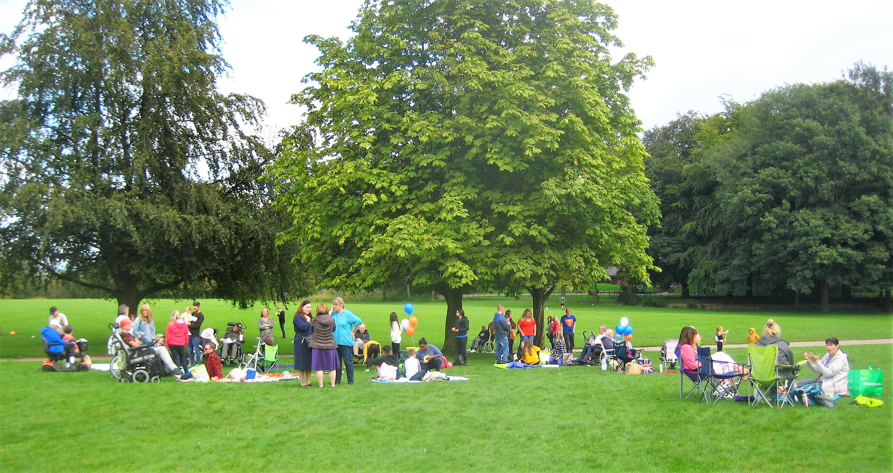
A Whole Family Approach
Supporting families with children and young People affected by Motor Neurone Disease.

Slide 2
Why support the family?
Working holistically means supporting those closest to the Person with MND
“When visiting I always take a packet of dreamies for the cat. That’s their family, its important to them!” AV Isle of White
Neighbours
PwMND
Offspring
Carers
Siblings
Nieces/Nephews
Grandchildren
Aunties/Uncles
Friends
Work Colleagues

Slide 3

Children and young people
Children and young people aged up to 18
Children up to 25 if there is an identified additional need
We as an Association believe that around 11% of families affected by MND have a child or young person living within the home
We support Grandchildren and other family members closely linked e.g. nieces/nephews
These children or young people may be providing caring responsibilities.

Slide 4
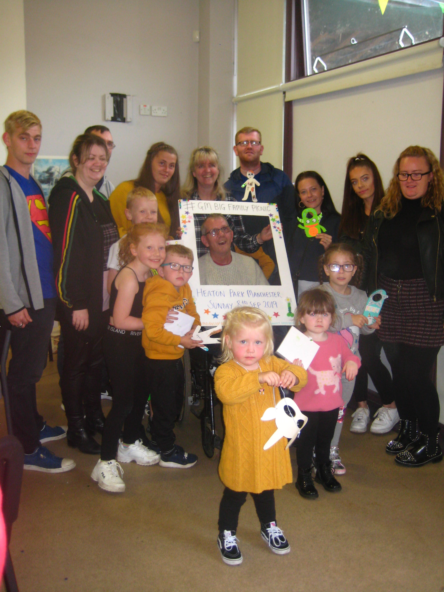
OUR Approach
The WHOLE Family
What we are asking you to do !
Supporting the wider family and including everyone in our approach
Not 1:1 support for children
Signposting to MND Association resources for children and young people
Signposting to external support services
Escalating complex issues as needed

Slide 5

Think Family
Some questions you may wish to ask !
Who else lives in your home ?
Who helps with your support and who is important in your life ?
Is there anyone who you provide support and care for ?
Is there a child in the family ( including step children, children of partners or extended family such as grandchildren) ?
As a volunteer, you can ask, “is there a child or young person living with you ?” or “Do you have any children in your extended family, such as grandchildren ?. If the answer is yes, then you can let people know that we have a range of specialist resources for them to use.

Slide 6
Your Toolkit
Resources to help support children and young people
we have a 2 page word document detailing all resources available, ask your ASC for a copy of this document
We have a CYP manager They can be contacted directly for guidance or if a family or child want a follow up call on 07702 336 744 or by emailing laura.willix@mndassociation.org
Dedicated website area
Provides information about MND, support options and news for CYP.
www.mndassociation.org/cyp
Children aged 4 to 10 years
Young People aged 11 to 18 years, and
Parents and Guardians

Slide 7
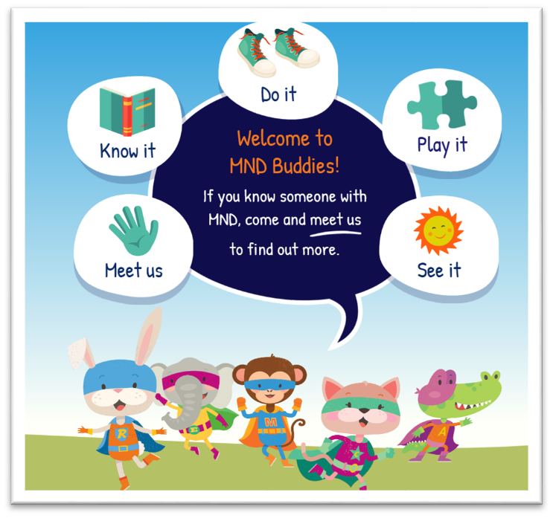
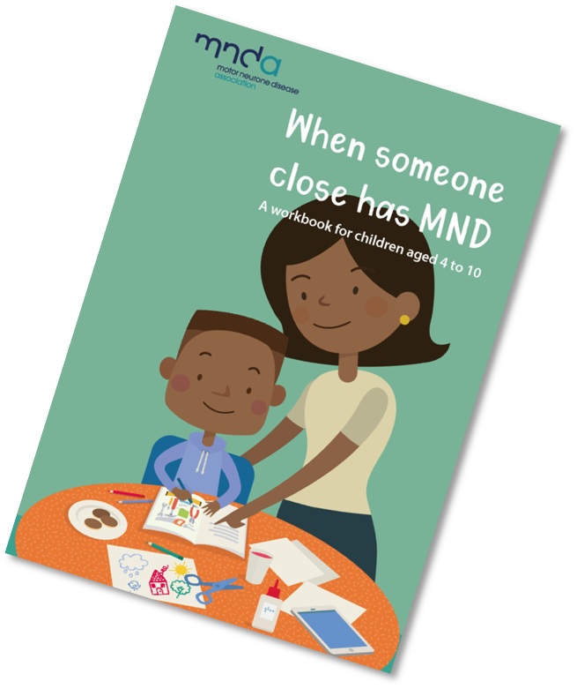
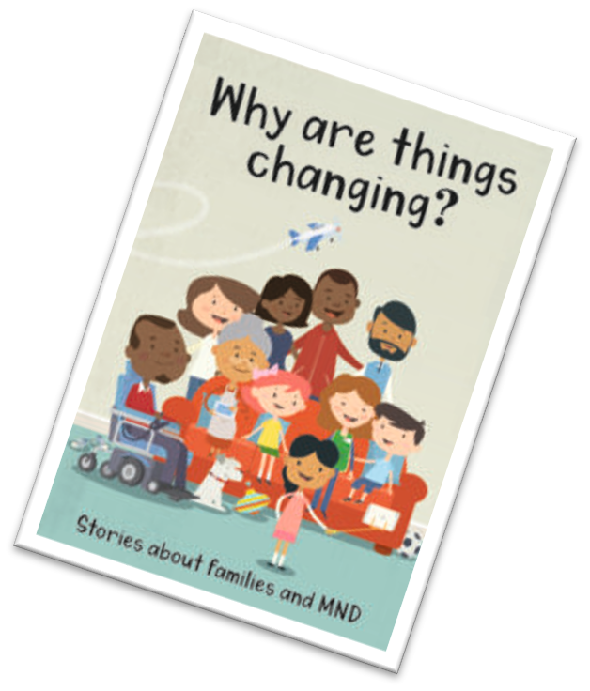
Current Resources for 4-10yr old
MND Buddies - special team of online characters that can help younger children find out about MND by accessing a range of games, stories and things to do with the MND Buddies online. Children can find them at their ‘Meet Us’ page whenever they need to at www.mndbuddies.org
Why are things changing?
A compilation of stories for children aged 4-11 about families with MND, to gently introduce some of the changes that will happen with the disease and help children begin to adapt
When someone close has MND
Our activity workbook for 4 -10 year olds to enable a trusted adult and a child communicate about MND at a pace that feels right for the child
All resources, books and information sheets can be ordered by phoning 0808 802 6262 or visiting mndconnect@mndassociation.org

Slide 8

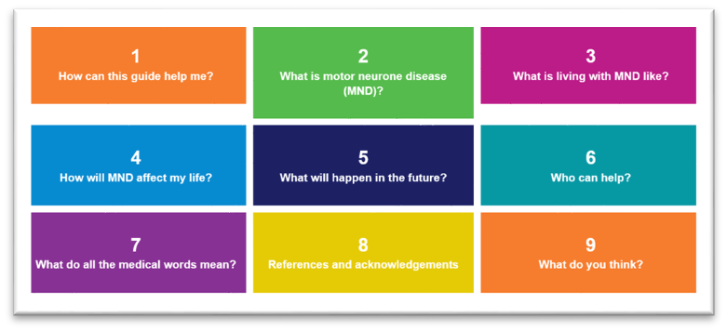
Resources for 11-18 year olds.
So what is MND anyway?
Our guide about MND for young people and young carers aged 11-18. Young people can order a hard copy, download a copy from our website or get a web app of the guide. Find these resources at www.mndassociation.org/ypinfo

Slide 9

Counselling for Children and Young people 4-25yr
New partnership with Barnardo’s to offer counselling for up to 40 families
National service
6-8 sessions by trained therapeutic staff
No/limited wait times
Referral through discussion with ASC and Children and young persons manager

Slide 10
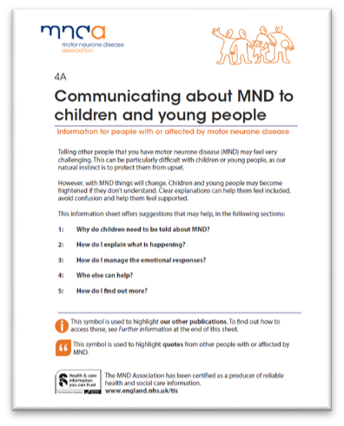
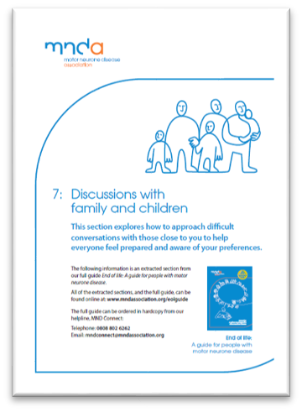
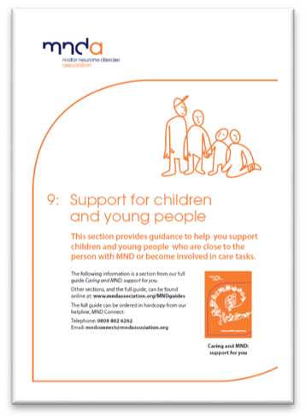

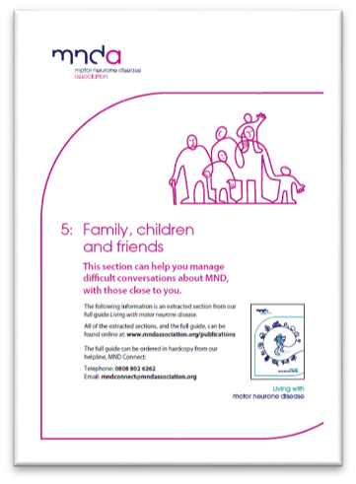
Literature for Parents and Guardians
All can be found on the website:-

Slide 11
Grants Available
Carers and young carers grant​
Up to £500 to allow the main non-paid carer to take a break from their caring duties. This may be a pamper day, a short break or assistance towards pursuing a hobby and can be applied for up to 12 months post bereavement.​
​
Young person grant​
Up to £250, for young people aged 18 or under, to support purchases of anything that may help them in their daily life. This may be a contribution to buying a laptop, going on a school trip or any type of financial support and can be applied for up to 12 months post bereavement.
Call Support Services on 0800 802 6262.

Slide 12
Examples of Good Practice
Signposting Examples | Practical Support Examples | Safeguarding
AV rang for support to refer a family to a locally young carers group- Information given to share | Volunteer identified need for CYP grant to purchase a printer for schoolwork
AV offered advice to family on how to tell school about diagnosis and what support is available | AV contacted the association as family had asked for help with a school appeal after it was suggested by their MP. The association helped to draft a letter of support with reference to young carers responsibilities and the impact of MND on pick up drop offs, locations of school and social support networks. The appeal was granted. | MND Connect received call from AV re who was supporting CYP at home. CYP worker contacted school. They was an allocated social worker and the children were on a children in need plan for emotional abuse, but parties were not joined up, or working in a holistic multi agency manner. Information shared about roles and responsibilities about all involved. Outcome was a more joined up approach with children supported safetly.
Family struggling to explain grandads condition to young children, signposted to MND Buddies and CYP manager for emotional support | Volunteer helped young children with fundraising. Silence Speaks, Walk to D’feet.

Slide 13
Escalating/Reporting a concern regarding a CYP
Your ASC or the Children and Young Persons Service development manager are available to offer any support when working with children, young people and families.
If you have any concerns about a family or children and young people you need to talk with your ASC who will decide whether the case needs escalating for further discussion.
Unless the child is in immediate danger when you would need to follow the safeguarding rules and call for emergency services.

